Slide 1



Slide 2
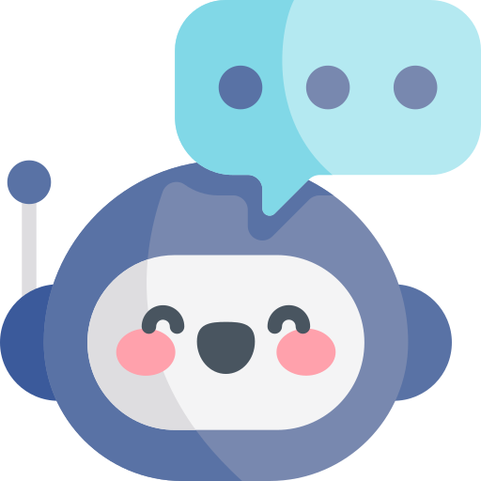
INTELLIBOT
AI Powered Chat Assistant

Slide 3
INTRODUCTION
The "Intellibot" chatbot project is a AI powered chat application that uses AI to provide intelligent responses to user input.
It supports multiple chat sessions, keeps a chat history, and can display image responses.
The chatbot can also convert text responses to speech and accepts voice input.
Users can customize the chat interface with different visual themes.
The project includes modal windows for prompts and alerts.
Overall, it combines AI-driven conversation, multi-chat support, & user-friendly features.

Slide 4
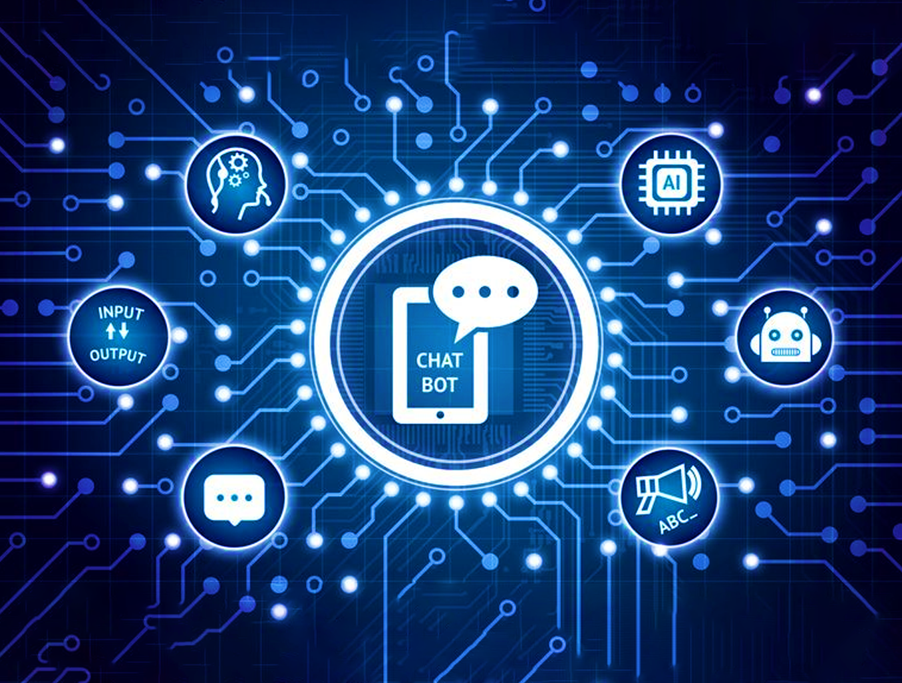
FEATURES OF INTELLIBOT
Image Generation
Voice Recognition
AI driven
Speech synthesis
Chat History
Customized Themes
Chat Interface
Multi Chat Support

Slide 5
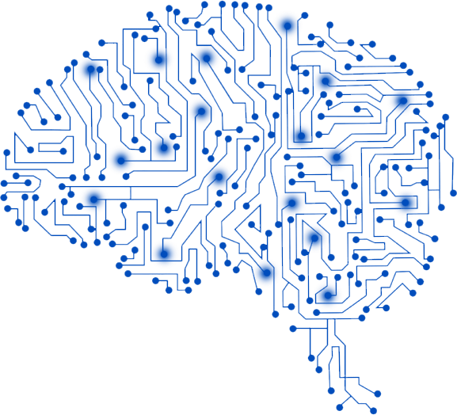

PEN AI
What is OpenAI? OpenAI is an artificial intelligence research organization and company that aims to ensure that artificial general intelligence (AGI) benefits all of humanity. OpenAI conducts research in various areas of AI and develops cutting-edge models and algorithms. OpenAI is known for Deep Learning Models Like GPT and Dall E.
What is AGI? AGI stands for Artificial General Intelligence. It refers to highly autonomous systems that possess the ability to outperform humans at most economically valuable work. Unlike narrow AI, which is designed for specific tasks or domains, AGI aims to exhibit the same level of intelligence and versatility as a human being across a wide range of tasks and domains. AGI is a significant milestone in AI development, as it represents a level of intelligence that surpasses human capabilities in many areas.

Slide 6

CHAT-GPT
DALL-E
ChatGPT is based on the GPT (Generative Pre-trained Transformer) series, with GPT-3.5 being one of the models within that series.
GPT models employ a Transformer architecture that consists of multiple layers of self-attention mechanisms and feed-forward neural networks.
DALL-E is a neural network-based model developed by OpenAI which is designed to generate high-quality and highly realistic images from textual description.
DALL-E is also based on the Transformer architecture. It uses a two-step process: encoding the textual prompt into a latent space and then decoding it to generate an image representation.

Slide 7
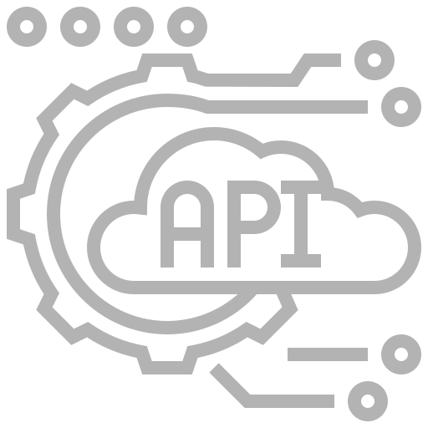

API
(Application Programming Interface)
An API (Application Programming Interface) is a set of rules and protocols that allows different software applications to communicate with each other.
They provide a standardized way for developers to access the functionalities and services of a particular software or platform without needing to understand its underlying implementation details.
An API key is a unique identifier or authentication token that grants access to an API. It serves as a credential to verify the identity and authorization of the user or application making requests to the API.
API keys are typically issued by the provider of the API to control access and usage. This key helps the API provider track usage, enforce access restrictions, and monitor API activities associated with your account.

Slide 8
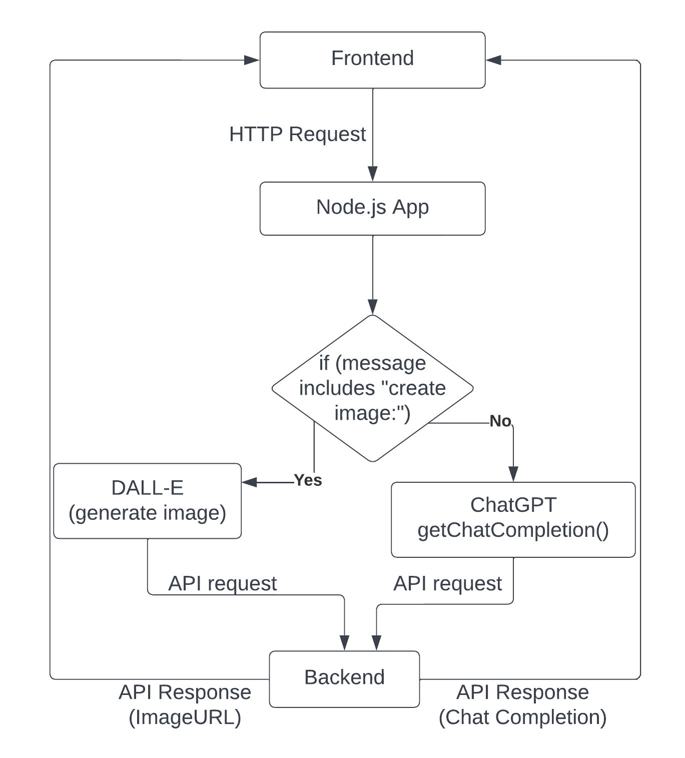
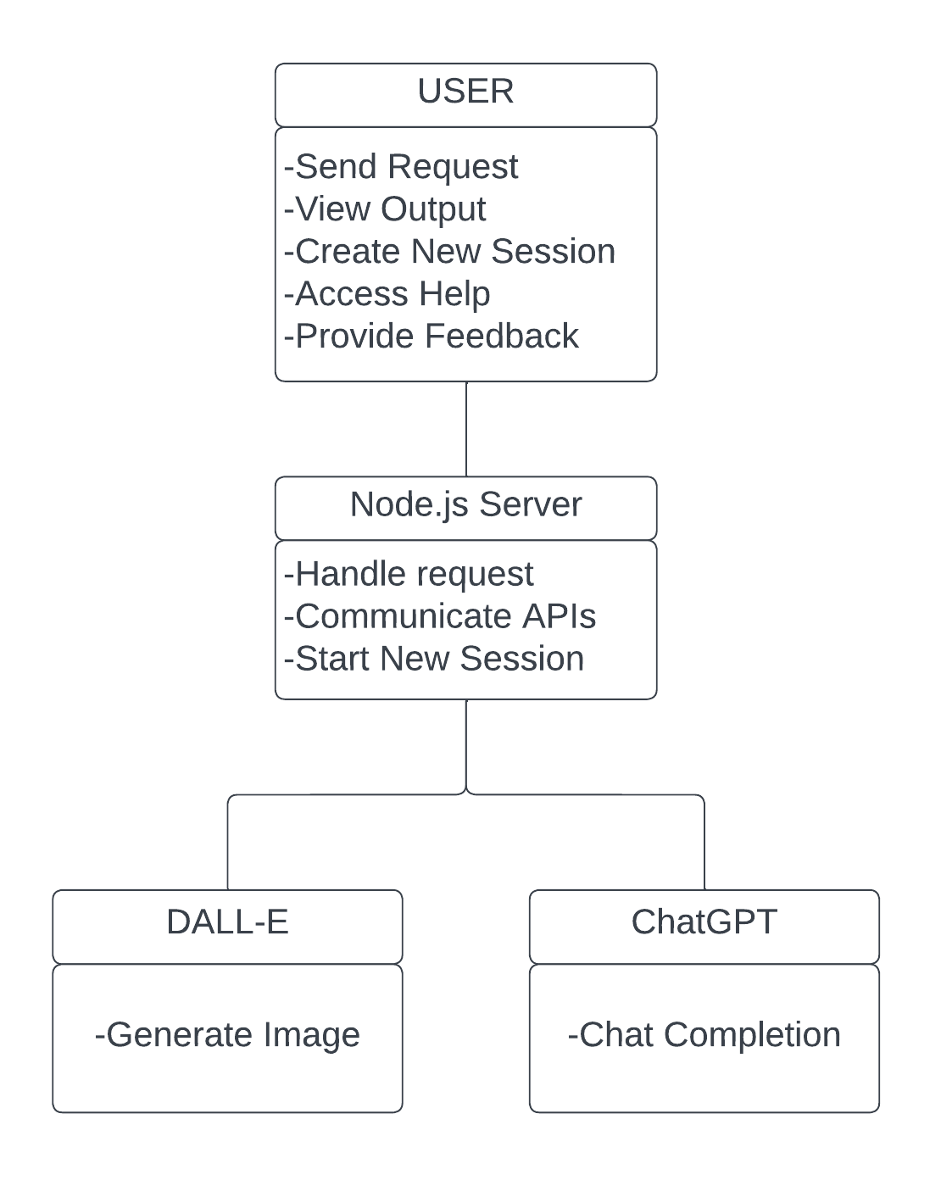
Unified Modeling Language Diagrams

Slide 9
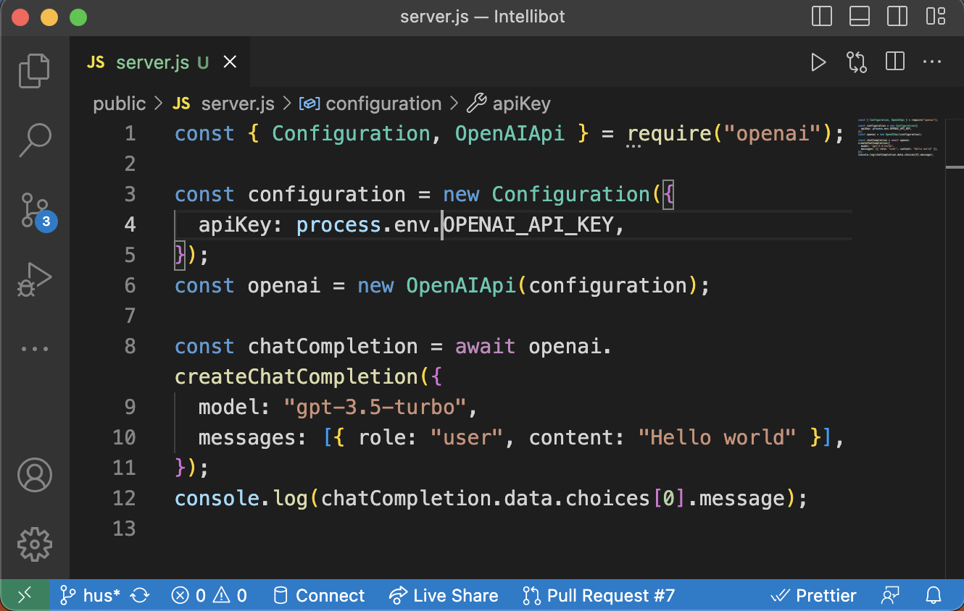
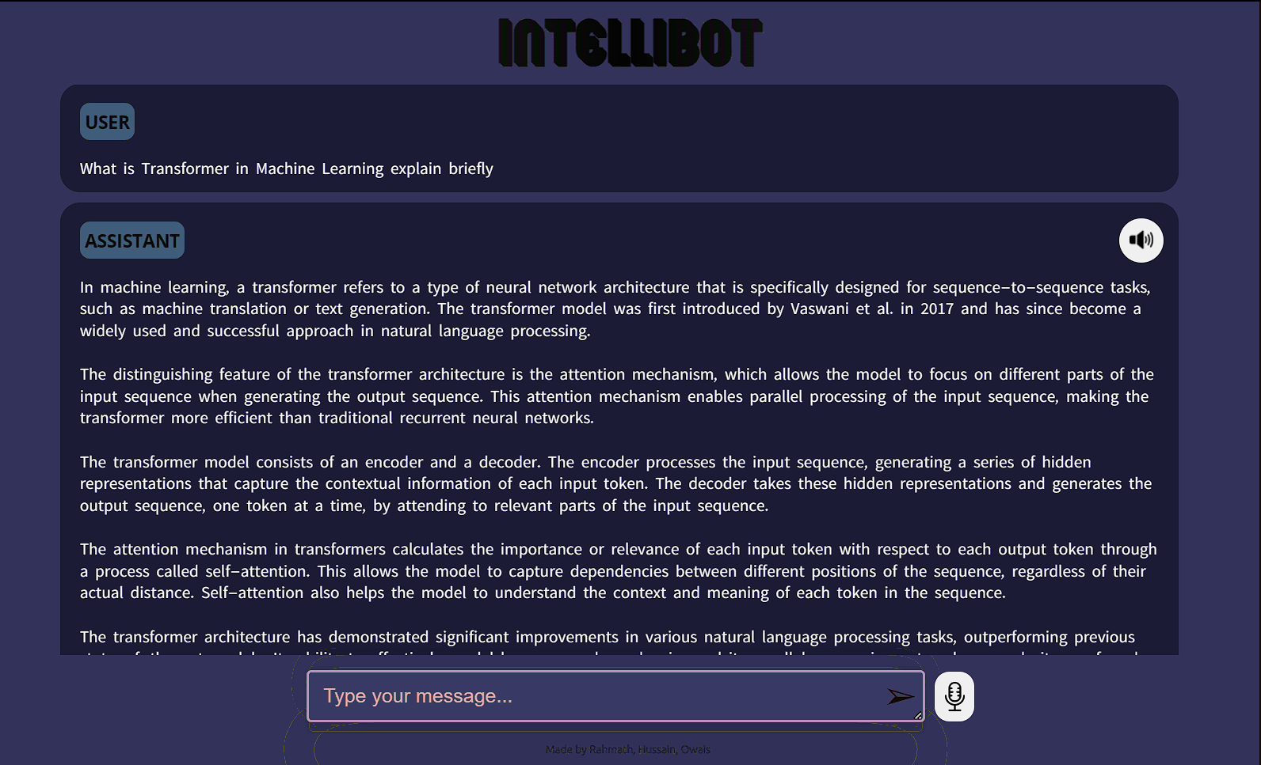
OPEN AI API INTEGRATION

Slide 10
OPEN AI API INTEGRATION

Slide 11
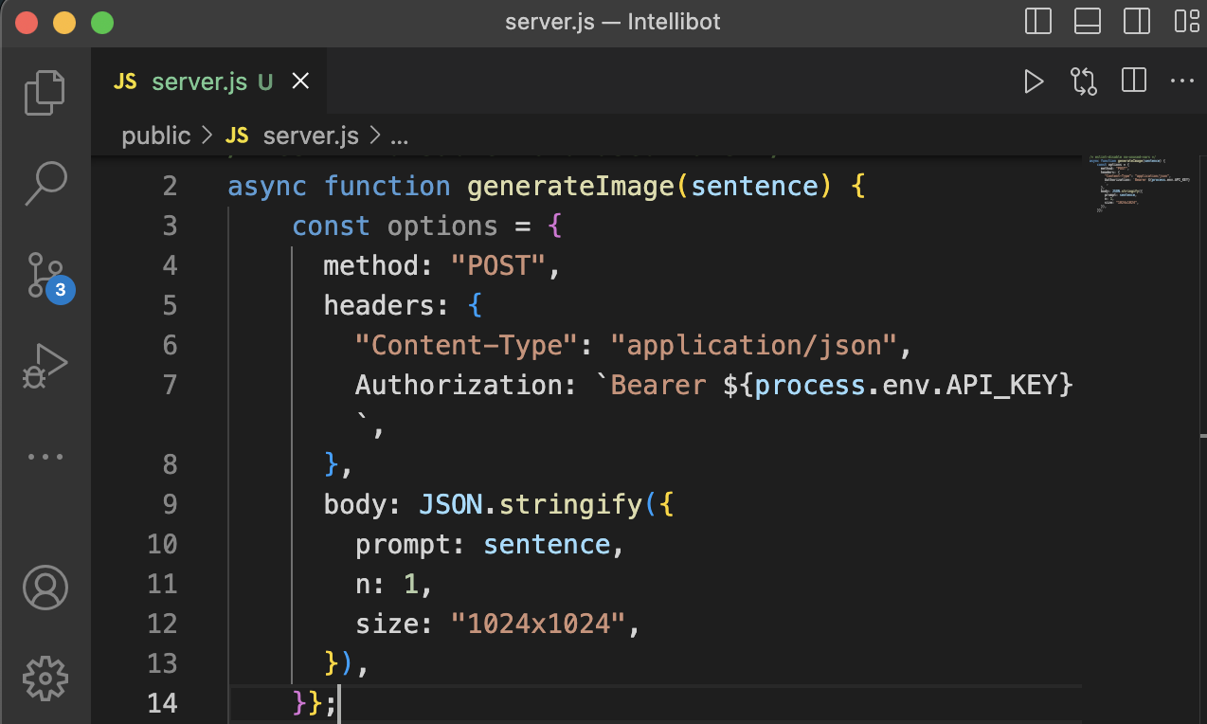
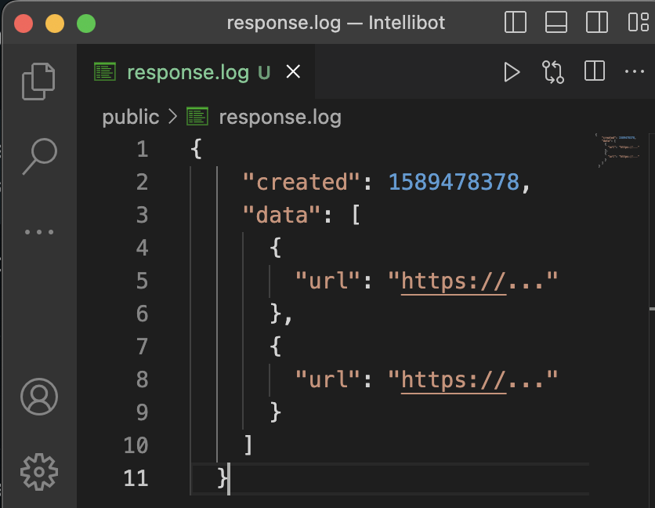
OPEN AI API INTEGRATION

Slide 12
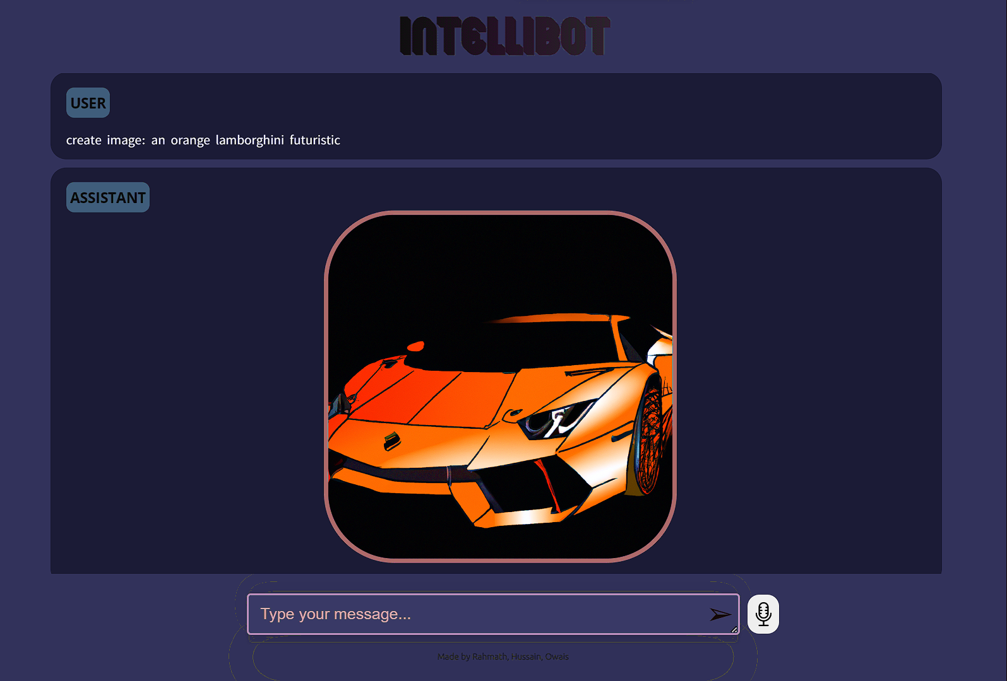
IMAGE GENERATION
Fine-Grained Control: DALL-E allows users to have fine-grained control over the generated images. By modifying or specifying details in the textual prompts, such as the pose, attributes, or appearance of objects, users can influence the characteristics and attributes of the resulting image.
Unseen and Abstract Concepts: DALL-E can generate images of objects or scenes that do not exist in reality. It can visualize abstract ideas or create images of fictional creatures, enabling exploration of novel visual representations beyond what is directly observable in the physical world.

Slide 13
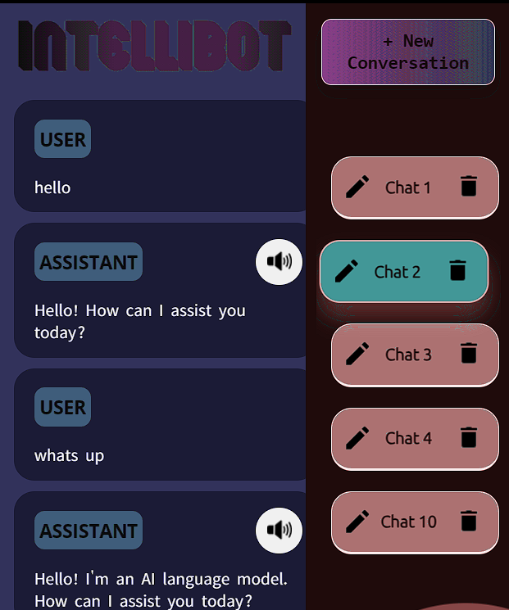
MULTI CHATS
CHAT HISTORY
Multi-Chat Support: The chat application supports multiple chat conversations simultaneously. Users can create new chat sessions, switch between different chats, and view the chat history for each conversation.
Chat History: The project keeps track of previous chat conversations, allowing users to review past interactions. The chat history is displayed in a sidebar, showing the titles of each chat session.

Slide 14

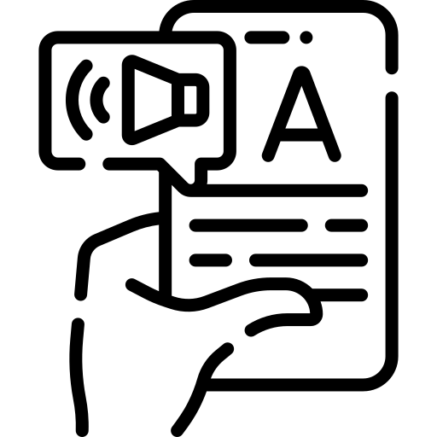
VOICE INPUT & SPEECH SYNTHESIS
Intellibot's voice input feature allows users to interact with the chatbot using their voice, making it more convenient and accessible for those who prefer not to type. With this feature, users can simply speak their questions or commands, and Intellibot will provide intelligent responses in real-time. Users can speak to Intellibot as if they were talking to a human, creating a more engaging and personalized chat experience.
Intellibot's Text-to-Speech (TTS) conversion feature allows users to hear the chatbot's responses instead of reading them. TTS also enhances the overall user experience by providing a more natural and conversational flow to the conversation.

Slide 15
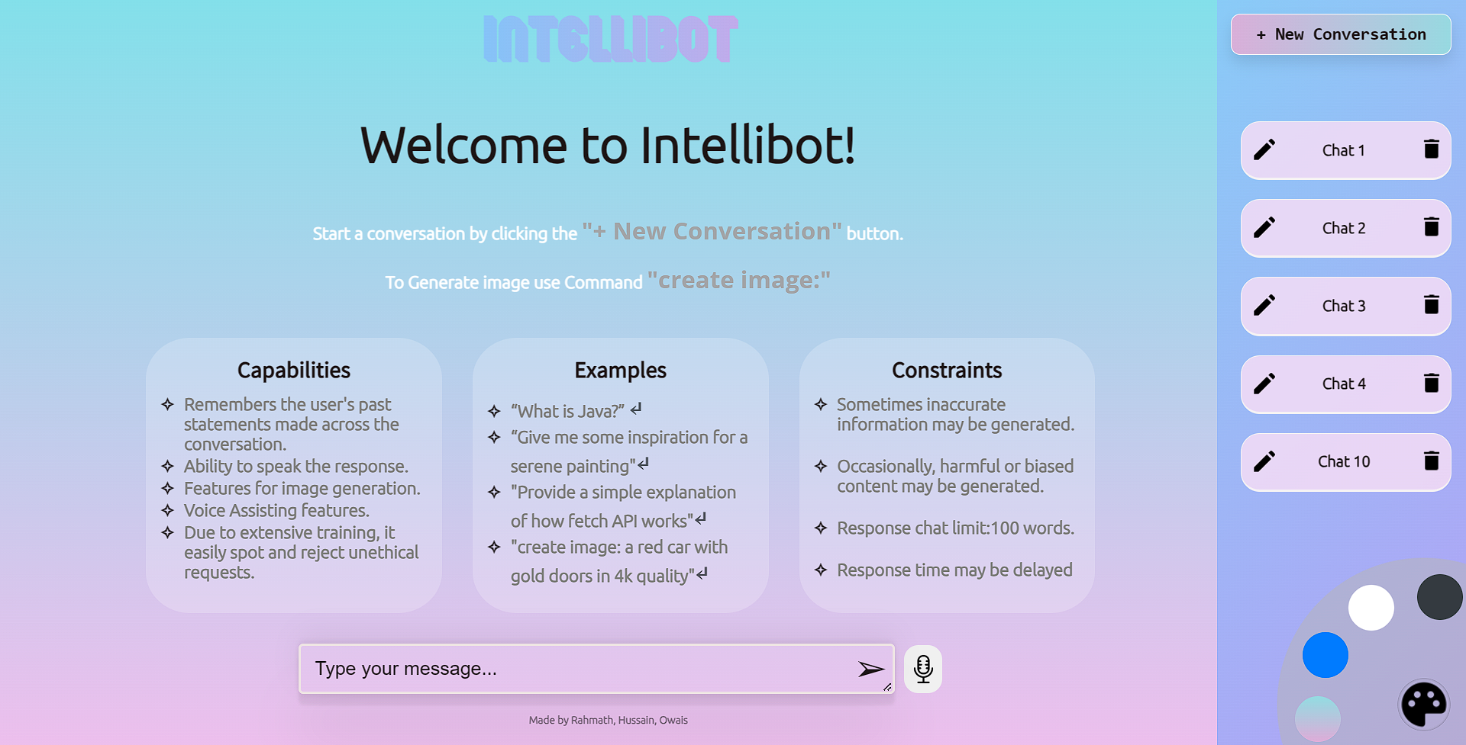
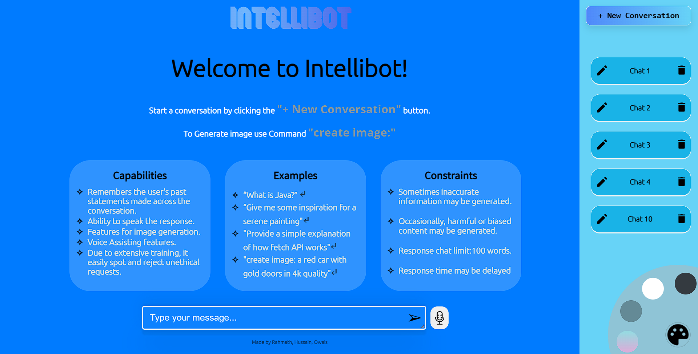
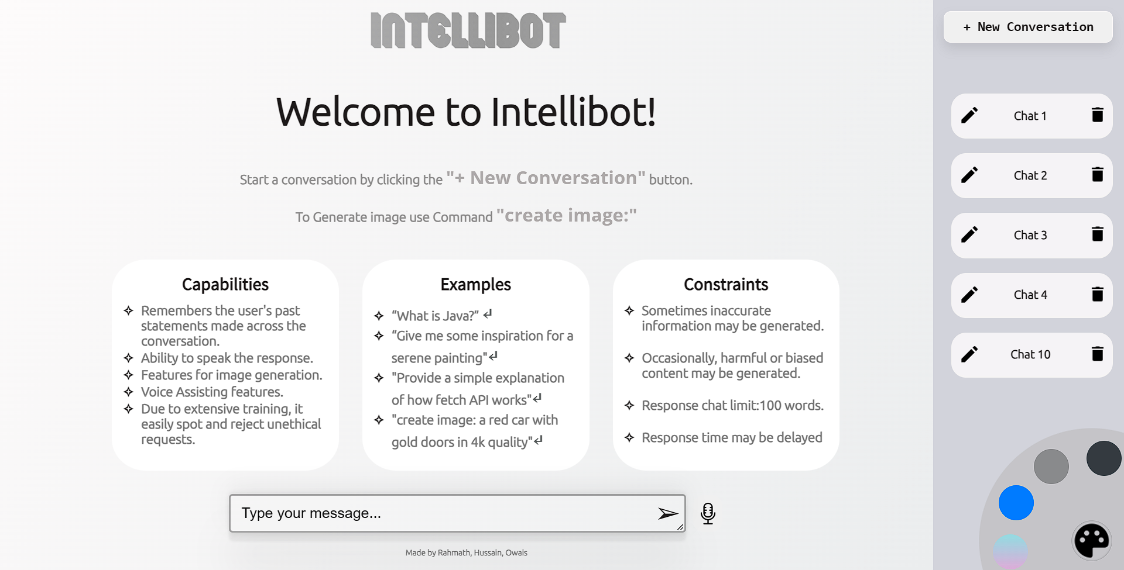
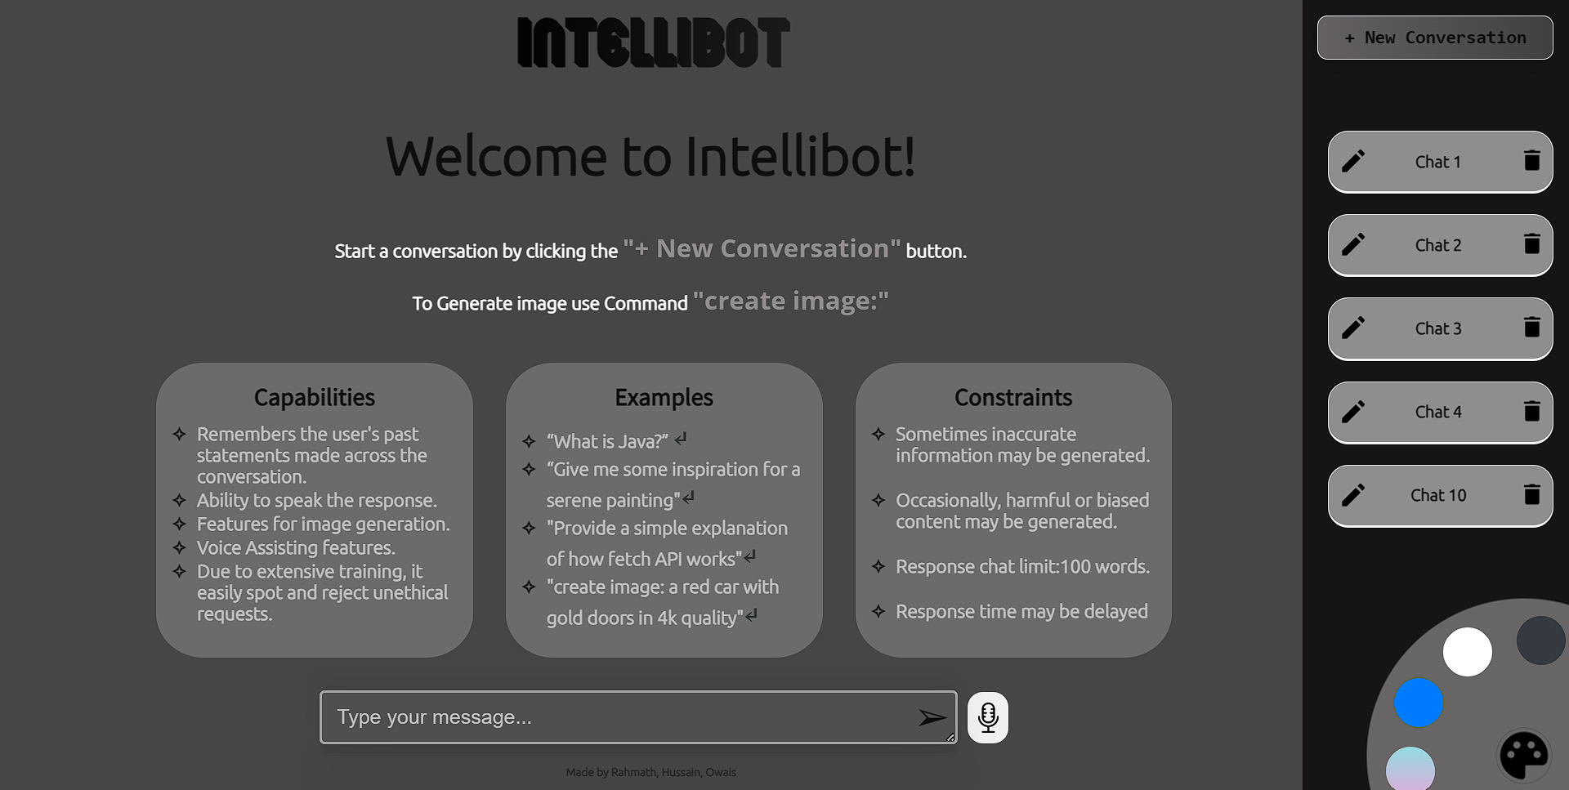
CUSTOMISED INTERFACE

Slide 16
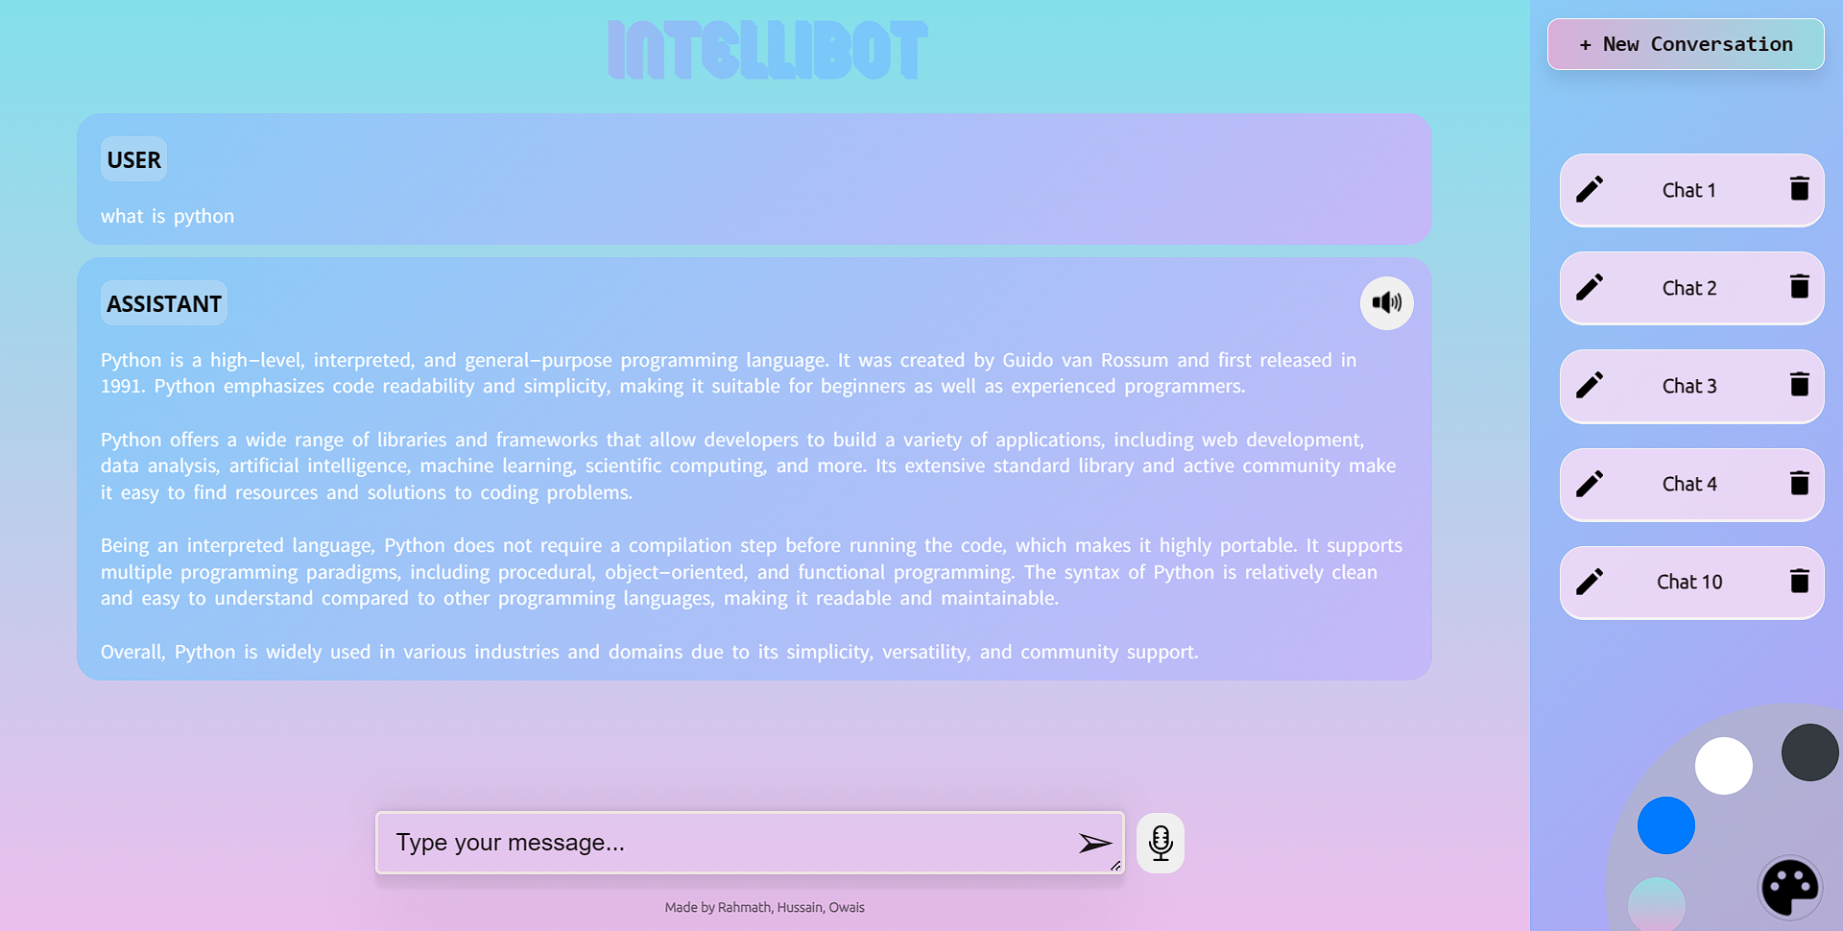
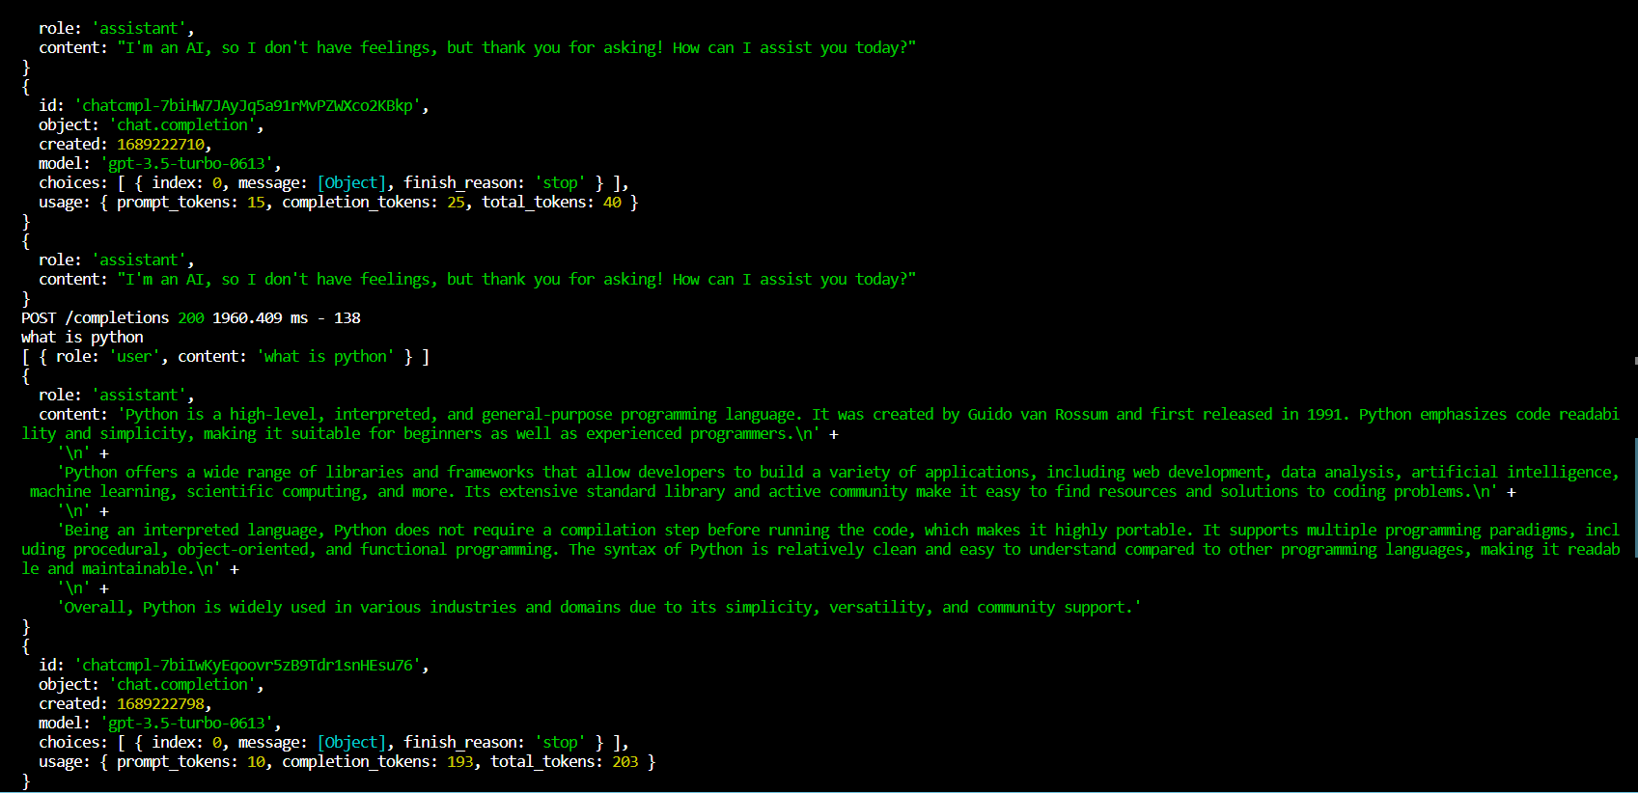
TECHNOLOGY USED
Front-End: React.js-Javascript Library & Framework CSS-Styles Modal-Customisable prompt
Back-end: Node.js-Javascript runtime environment Morgan-Http logging library Openai-Nodejs library to provides convenient access to the Open ai API

Slide 17
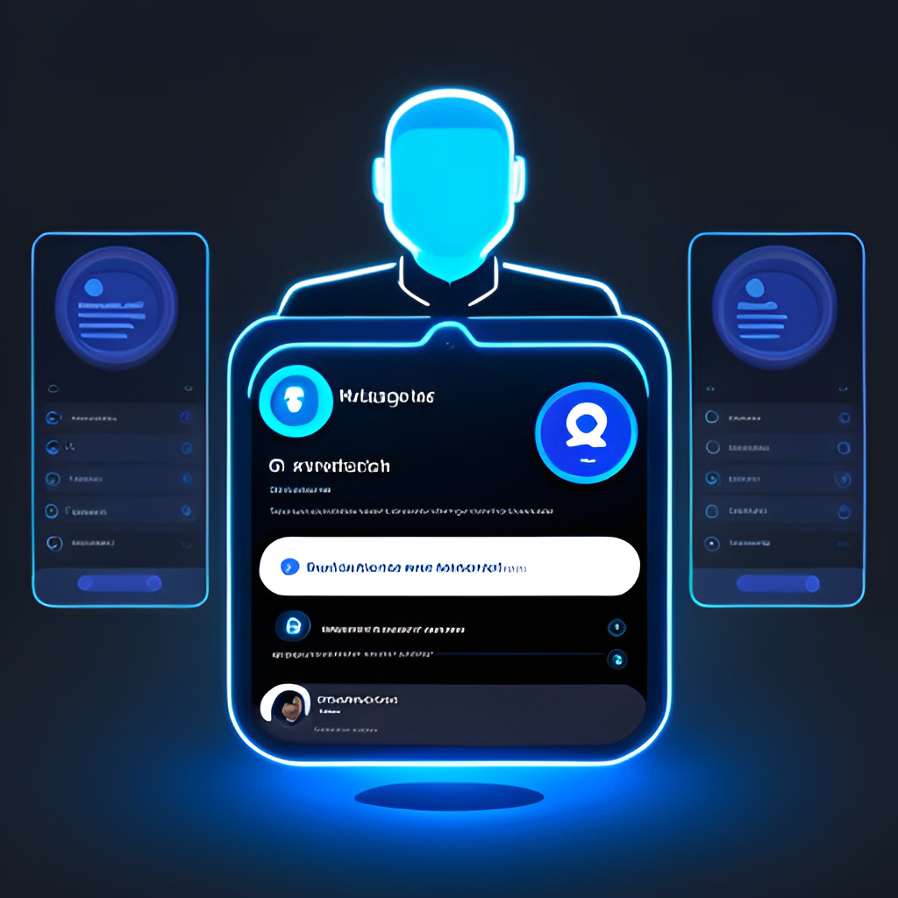
CONCLUSION
In conclusion, Intellibot offers a range of features that provide a user-friendly and personalized chat experience. With its Al-driven conversation, Intellibot can understand the context of a user's input and provide intelligent responses.
Users can also customize the chat interface with different visual themes, and enjoy the convenience of voice input and text-to-speech conversion. Additionally, Intellibot supports multi-chat sessions and keeps a chat history, making it easy for users to continue conversations across different platforms.
One of the most unique features of Intellibot is its ability to display image responses, adding a new dimension to the chat experience. Modal windows are also used for prompts and alerts, enhancing the user experience even further.
In short, Intellibot is an Al-powered chat assistant that provides a seamless and personalized chat experience, setting it apart from other chatbots on the market.

Slide 18
THANK YOU!

